Slide 1
BÁO CÁO TIẾN ĐỘ
01
Giới thiệu về HTML
Table of Contents
02
Cơ bản về CSS
JavaScrip Cơ bản
03
HTML Forms và Input Elements
04
05
Quy trình phát triển web
Hoàng Hải Nam
Lớp: 20CN5

Slide 2
01
Table of Contents
02
03
04
Giới thiệu về HTML
Cơ bản về CSS
JavaScrip Cơ bản
HTML Forms và Input Elements
05
Quy trình phát triển web

Slide 3
01
Giới thiệu về HTML

Slide 4
Hướng dẫn tạo một tệp HTML cơ bản
01
02
Cú pháp cho HTML
Các phần tử HTML cơ bản

Slide 5
Hướng dẫn về cú pháp và các phần tử HTML cơ bản
Your logo

Slide 6
02
Cơ bản về CSS

Slide 7
01
02
Thêm kiểu cho trang web bằng CSS
Tạo lớp và áp dụng kiểu bằng cách sử dụng lựa chọn
03
Thử nghiệm với các thuộc tính CSS cơ bản

Slide 8
03
JavaScrip Cơ bản

Slide 9
Giới thiệu cú pháp JavaScript cơ bản
Tạo biến, hàm và sử dụng sự kiện
Ví dụ đơn giản

Slide 10
04
HTML Forms và Input Elements

Slide 11
Tạo biểu mẫu HTML đơn giản
Tạo kiểu cho biểu mẫu bằng CSS
Sử dụng JavaScript để xử lý dữ liệu từ biểu mẫu

Slide 12
05
Quy trình phát triển web

Slide 13
Mercury
Venus
01
02
Mercury is the closest planet to the sun
Venus is the second planet from the sun
Jupiter
Neptune
03
04
Jupiter is the biggest planet of them all
Neptune is the farthest planet from the Sun

Slide 14
Thanks!
Do you have any questions?
youremail@freepik.com
+91 620 421 838
yourcompany.com
Please keep this slide for attribution

Slide 15
Main Competitors
 | Mercury | Jupiter | Venus | Neptune

Slide 16
Our Company
Your logo
Mercury is the closest planet to the sun and the smallest one in the solar system—it’s only a bit larger than the Moon. The planet’s name has nothing to do with the liquid metal, since Mercury was named after the Roman messenger god

Slide 17
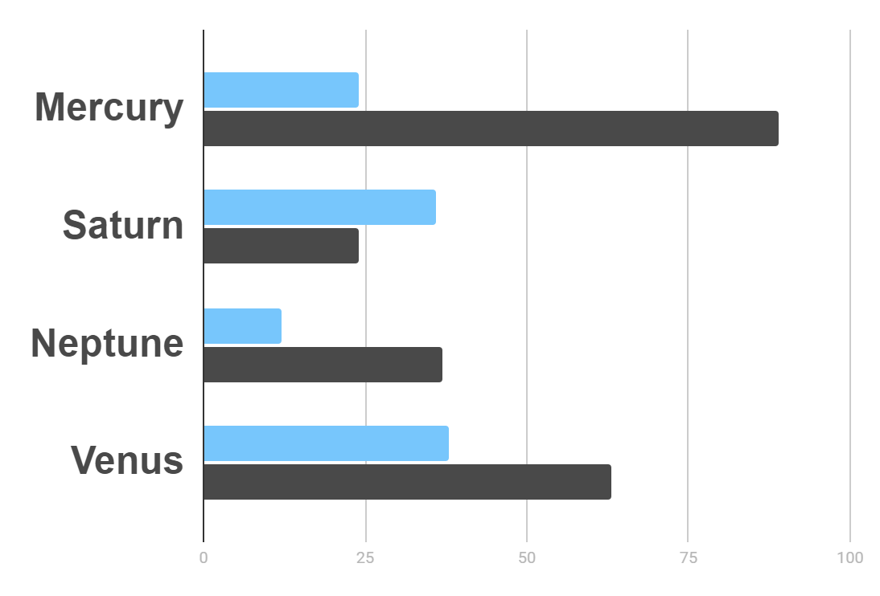
Market Research
Evolution
$20K
Gross Revenue in the Sector
10%
45K
To modify this graph, click on it, follow the link, change the data and paste the resulting graph here
Sector Growth

Slide 18

—Someone Famous
“This is a quote, words full of wisdom that someone important said and can make the reader get inspired.”

Slide 19
Awesome Words

Slide 20
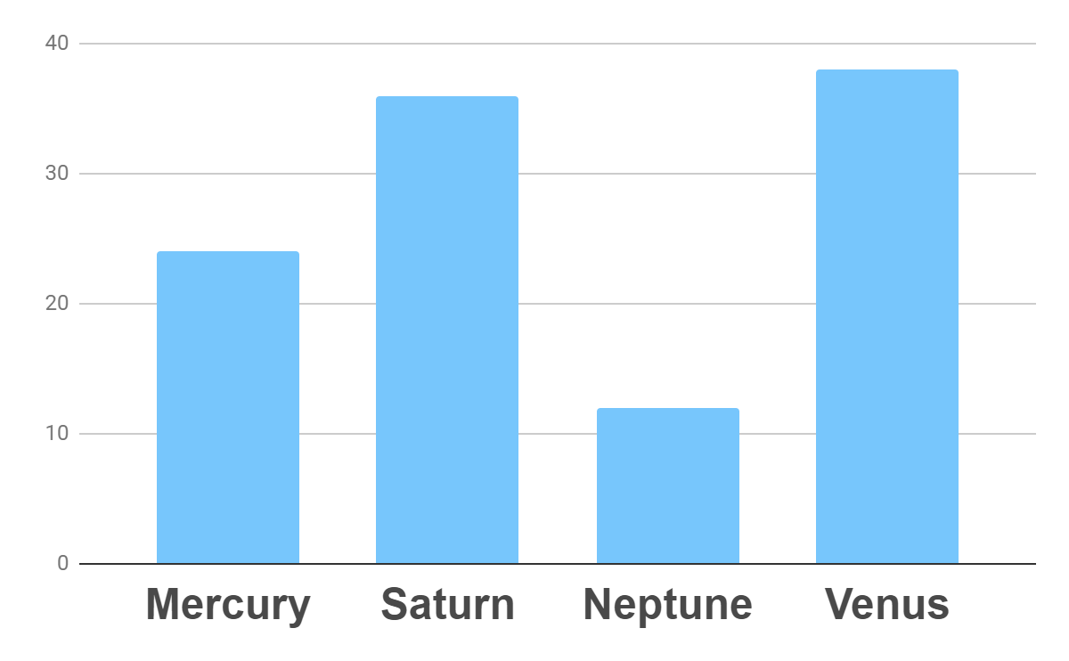
Analysis
Outreach
Top Rated Values
To modify this graph, click on it, follow the link, change the data and paste the new graph here

Slide 21
333,000.00
24h 37m 23s
386,000 km
earths is the sun’s mass
is Jupiter’s rotation period
is the distance to the Moon

Slide 22
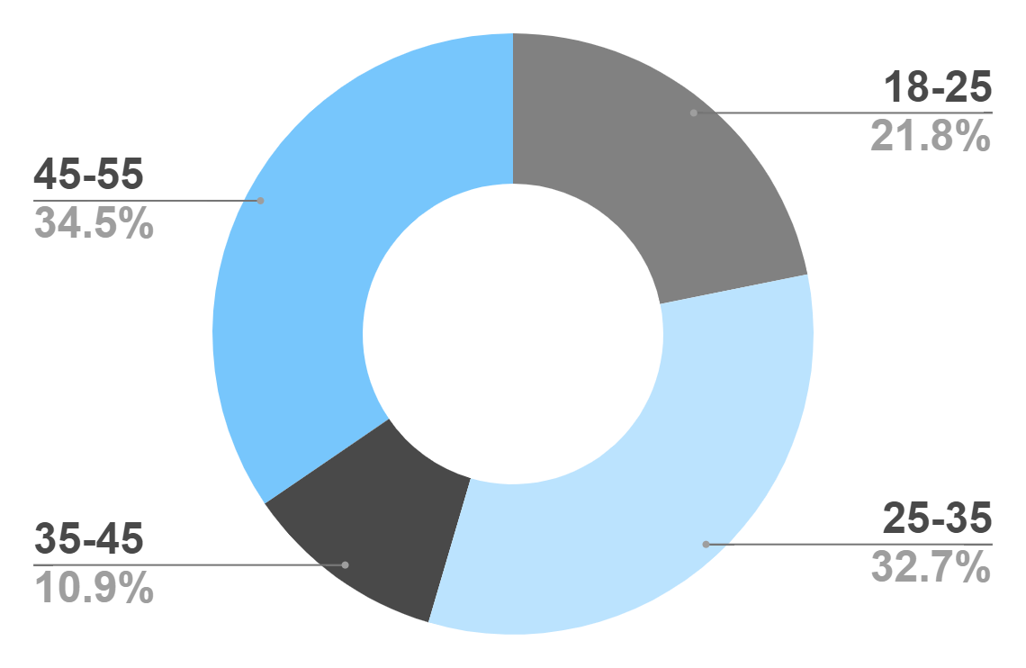
Target
Age
Gender
30%
70%
Interests
Security
Usability
To modify this graph, click on it, follow the link, change the data and paste the new graph here
Interface

Slide 23
Our Process
Mercury is the closest planet to the Sun
Venus is the second planet from the Sun
Day 1
Day 2
Day 3
Day 4
Jupiter is the biggest planet in the Solar System
Neptune is the farthest planet from the Sun

Slide 24
Whoa!
This could be the part of the presentation where you can introduce yourself, write your email…

Slide 25
Our Consultants
John James
Venus is the second planet from the Sun
Jane Patterson
Joe Doe
Mercury is the closest planet to the Sun
Neptune is the farthest planet from the Sun

Slide 26
Our Partners
Lập kế hoạch (Planning)
Phân tích yêu cầu (Requirement Analysis)
Thiết kế (Design)
Phát triển (Development)
Kiểm thử (Testing)
Triển khai (Deployment)
Quản lý dự án (Project Management)

Slide 27
Awards
Mercury
It’s the closest planet to the Sun
Venus
Venus is the second planet from the Sun
Jupiter
Jupiter is the biggest planet of them all

Slide 28
Testimonials
Helena James
“Mercury is the closest planet to the Sun”
Jenna Doe
“Jupiter is the biggest planet of them all “
Mary Patterson
“Neptune is the farthest planet from the Sun”

Slide 29
498,300,000
Big numbers catch your audience’s attention

Slide 30
Upcoming Goals
January
February
March
April
Goal 1
Phase 1
Phase 2

Slide 31
The Slide Title Goes Here!
Do you know what helps you make your point clear? Lists like this one:
They’re simple
You can organize your ideas clearly
You’ll never forget to buy milk!
And the most important thing: the audience won’t miss the point of your
presentation

Slide 32

A Picture Is Worth a Thousand Words

Slide 33
Infographics Make Your Idea
Understandable…
Mercury
Neptune
Mercury is the closest planet to the Sun
Neptune is the farthest planet from the Sun
Jupiter
Saturn
Jupiter is the biggest planet of them all
Saturn is the ringed one and a gas giant

Slide 34
…And the Same Goes for Tables
 | Mass (earths) | Diameter (earths) | Gravity (earths)
Mercury | 0.06 | 0.38 | 0.38
Mars | 0.11 | 0.53 | 0.38
Saturn | 95.2 | 9.4 | 1.16

Slide 35
Maybe You Need to Divide the Content
01
02
Neptune
Jupiter
Neptune is the farthest planet from the Sun and the fourth-largest in the Solar System
Jupiter is the biggest planet in the Solar System and the fourth-brightest one

Slide 36
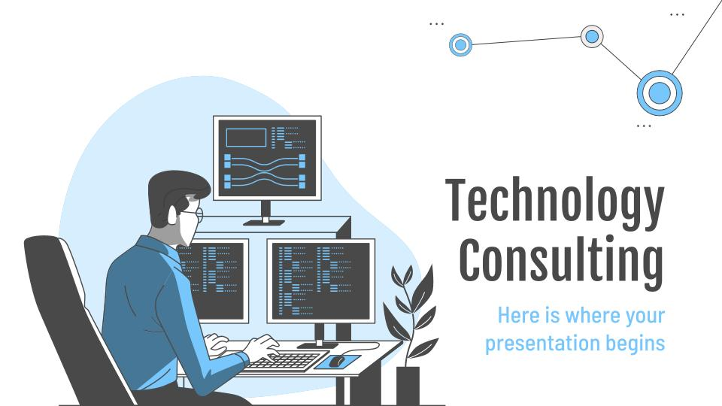
Desktop Software
You can replace the image on
the screen with your own
work. Just delete this one,
add yours and center it properly

Slide 37
Alternative Resources
Find more illustrations like these on Stories by Freepik

